Slide 1
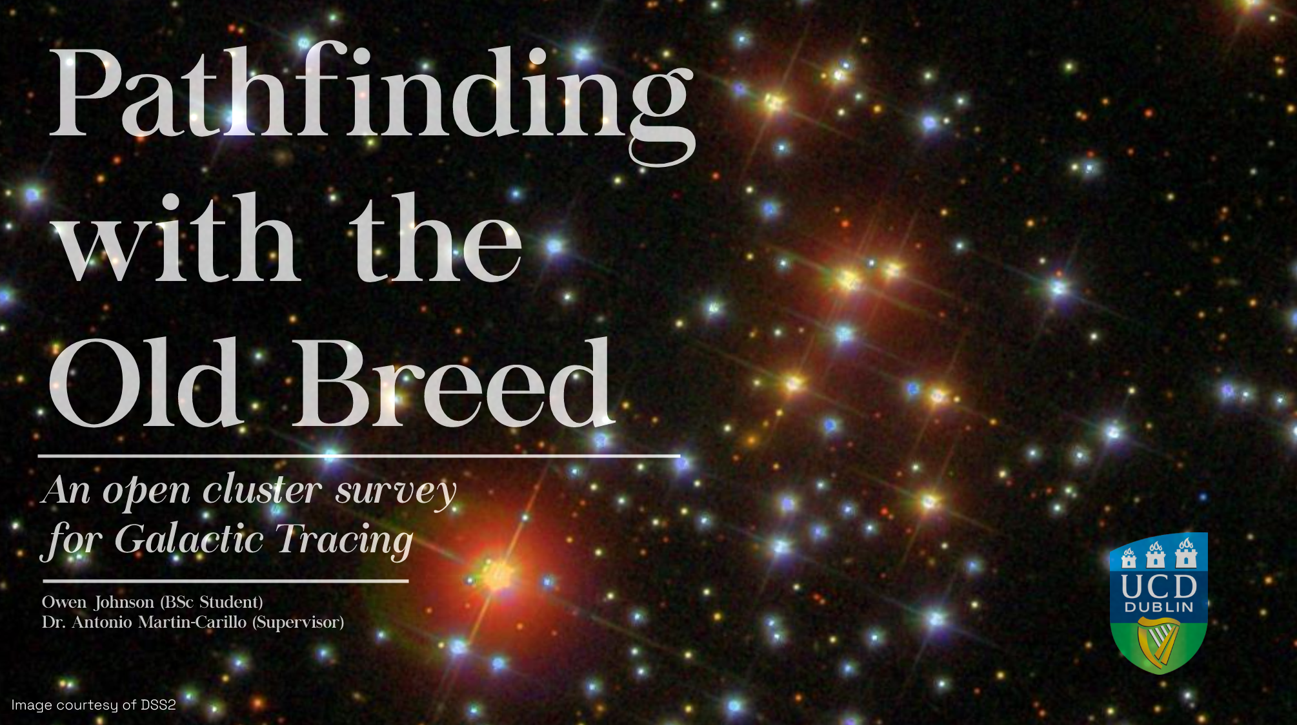

Slide 2
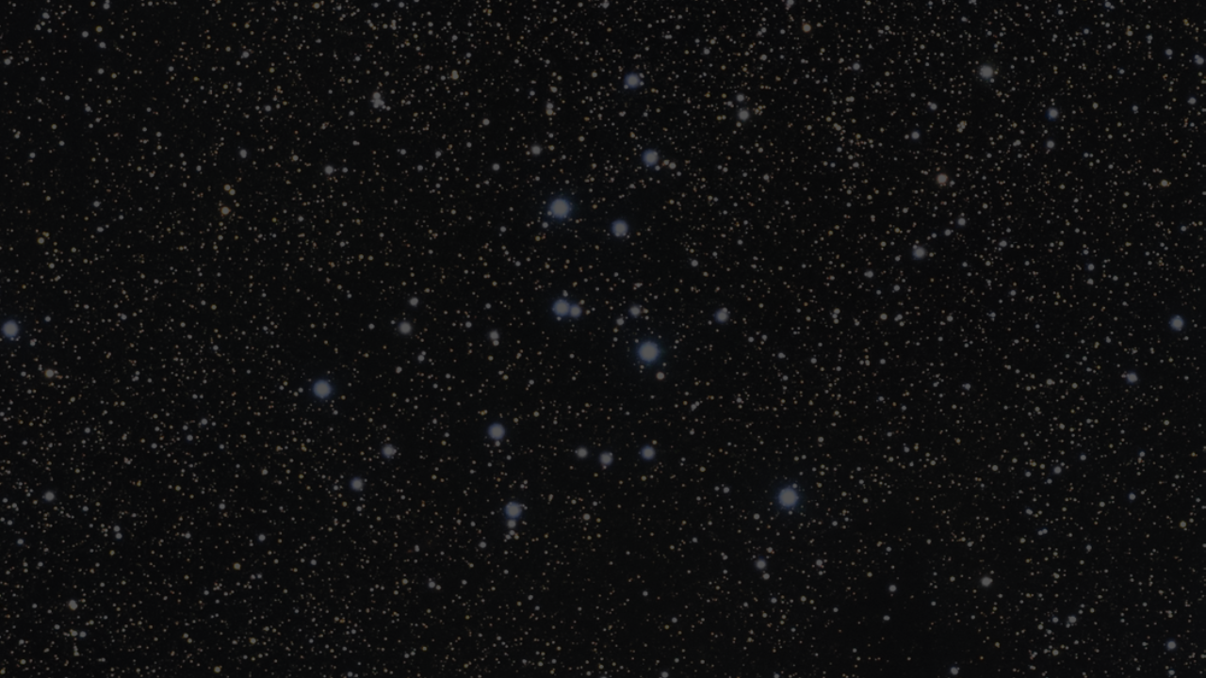
“The heavens are now seen to resemble a luxuriant garden, which contains the greatest variety of productions, in different flourishing beds.”
- Sir William Herschel

Slide 3

Objectives and Motivation
Primary Objective
Observe open cluster with little use in galactic tracing
Determine cluster’s population using methods from modern studies and algorithms
Explore relationships between parameters and Galactic position.
Secondary Objective
Classify observed clusters according to the Trumpler scheme
Nicely catalog stellar population of each observed cluster.
Motivation
Lots of data, no one to analyze.
Large development in isochrone research in the last 2 decades
Aid Gaia’s second data release (GDR2)
Resurgence of similar studies [Xiang, M., Rix, HW. (2022)]
I really like the idea of cataloguing stars

Slide 4
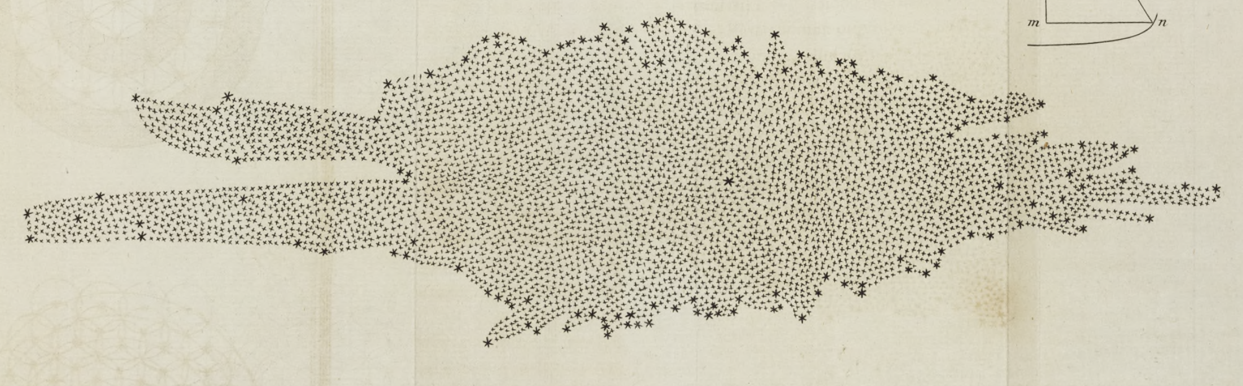
A Brief History on Galactic Tracing and Open Clusters
1785: William Herschel publishes ‘on the construction of the heavens’ detailing one of the first formal mappings of the milky way
1918 – 1930: Harlow Shapley & Robert Trumpler use classification schemes and cluster parameters to try relate milky way structure.
1960 – 90’s: Van de Burgh, Becker and Fenkart conduct first studies mapping the arms of the milky way using open clusters.
1980’s – 2010’s: Lynga and Janes
et al. perform mass isochrone fitting
and cataloging.
2010’s – Present: Dozens of machine
learning and statistical studies looing at 1000’s of clusters

Slide 5
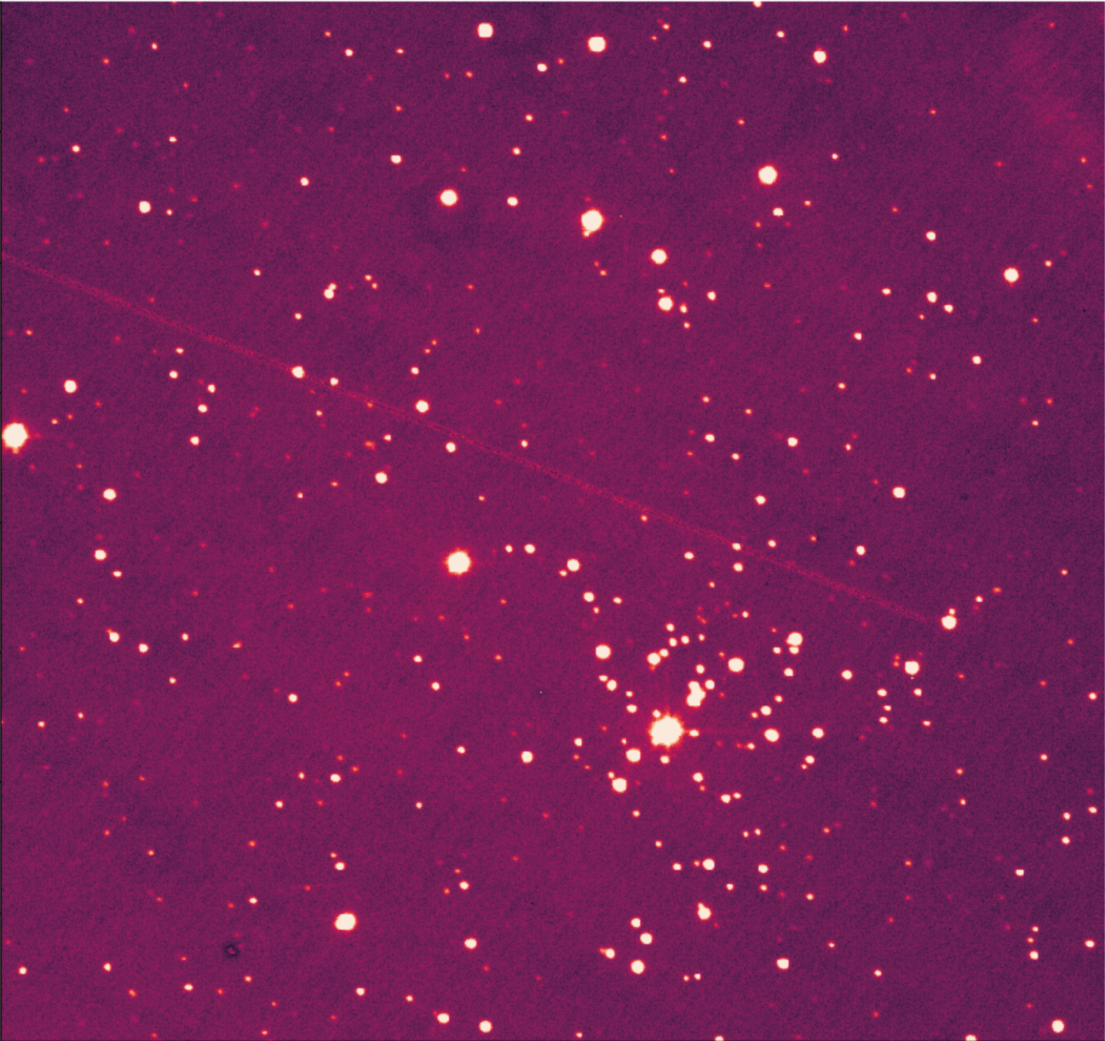
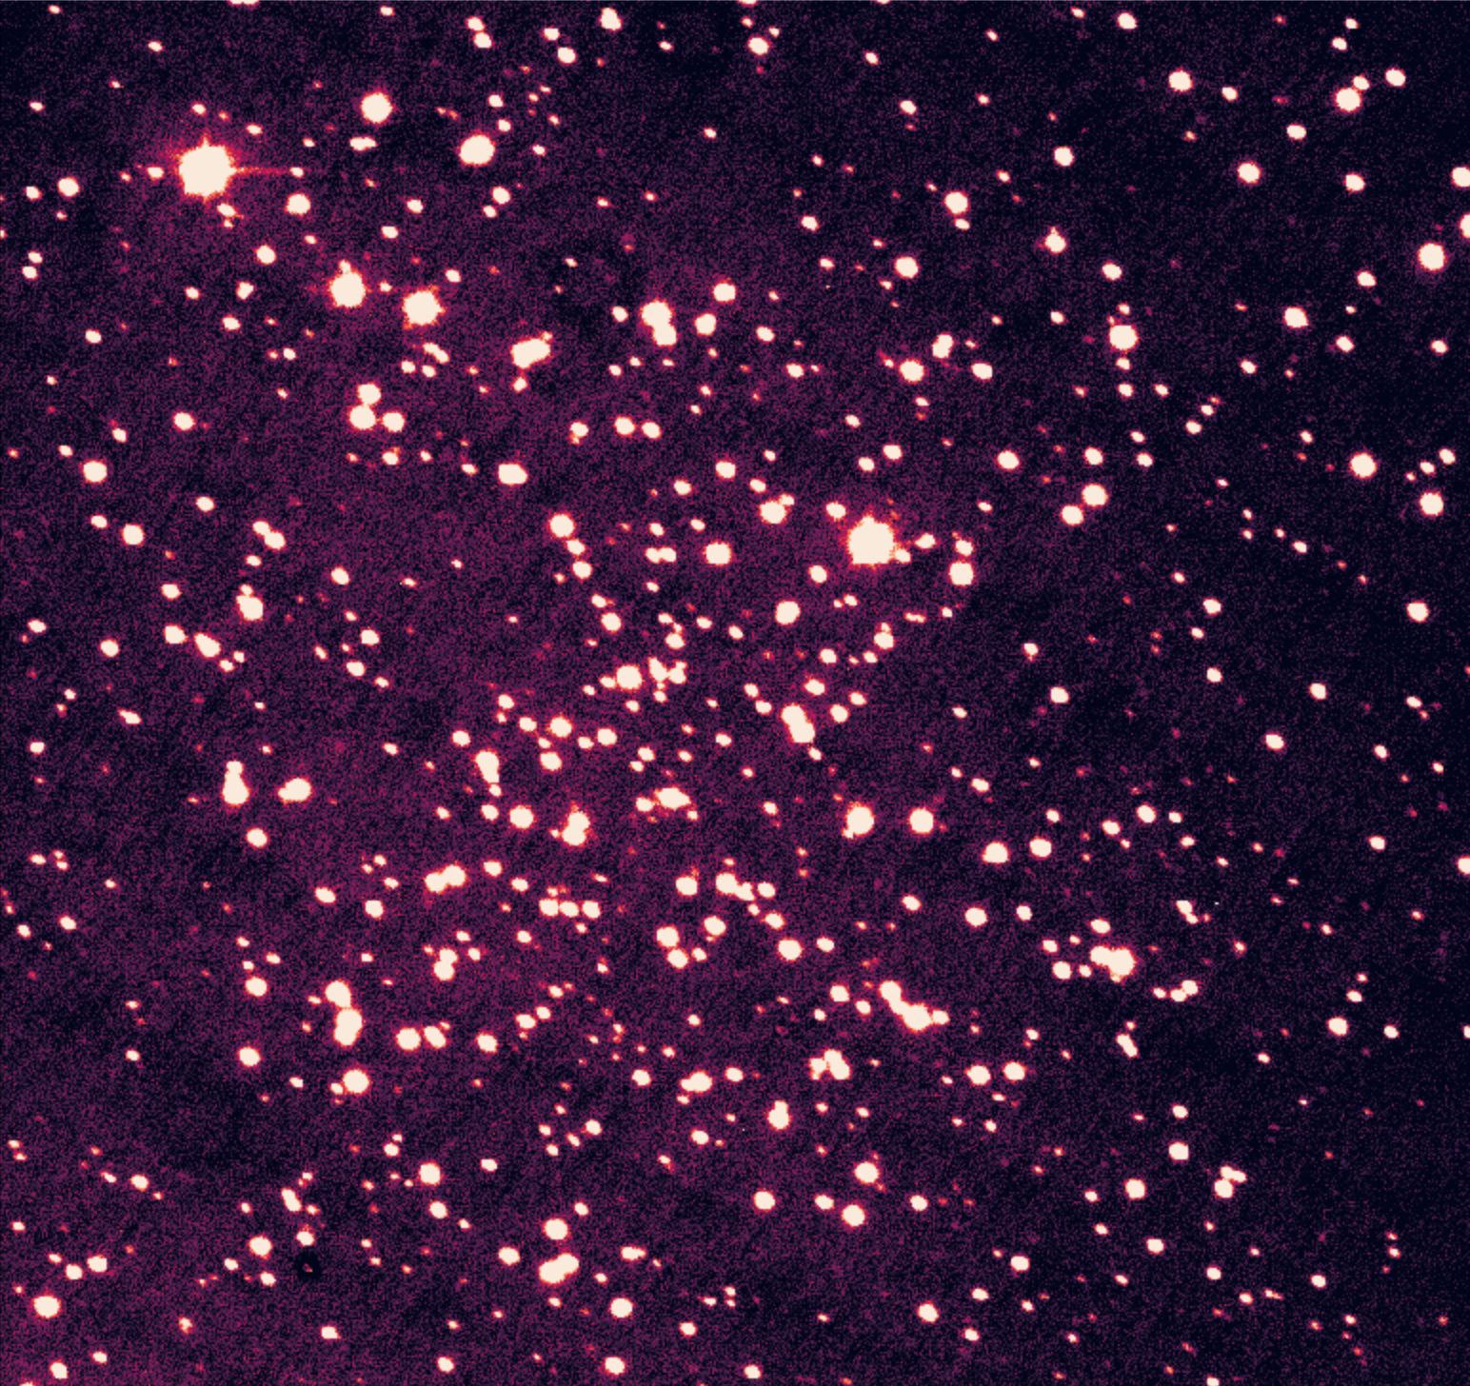
What are Open Cluster?
Berkeley 28
Stellar populations of ⪅ 1000
Most are younger than globular cluster
Loose gravitational bound
High enrichment metallic mainly population I stars
Homogenous populations, makes them ideal to use as galactic laboratories.
NGC 2324

Slide 6
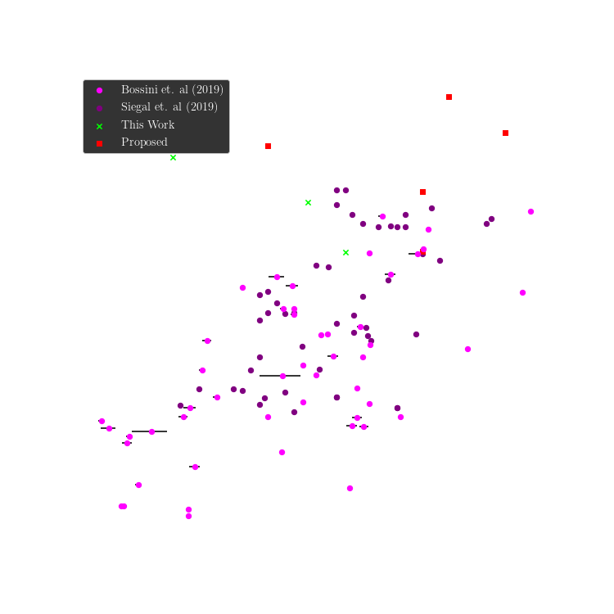
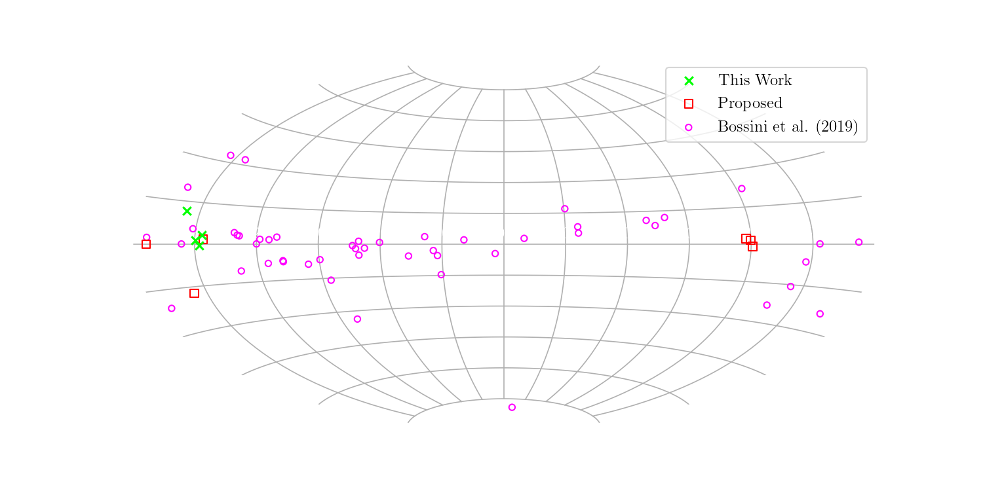
Target & Data Selection Strategy

Slide 7
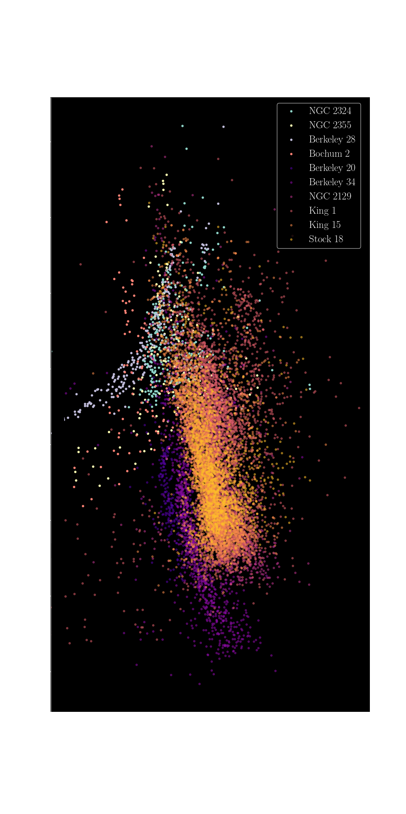

Determining Cluster Parameters
We’ve now have clusters of interest how do we learn about them?
Through fitting isochrones to colour magnitude diagrams (CMDs)
Isochrone $→$ a curve that can be fitted to a Hertzsprung-Russell (H-R) diagram that details the evolution of stars with specific parameters (age, Fe/H, Av, distance)
CMDs $→$ diagram variant of H-R diagram using magnitude (y-axis) and colour (x-axis)

Slide 8
Obstacles in Fitting Isochrones
The prominent problem in determining open cluster parameters
Are the detected stars members of the cluster?
Reason for problem: Open clusters have no discernable shape so that puts conventional spatial distribution profiling out the window

Slide 9
Possible Solutions to the Problem
Open Clusters do have a homogenous stellar population, we then turn to clustering on the CMD and metallicity distribution of targets!
Use of an astrometric study such as Gaia’s second data release to determine population members!

Slide 10
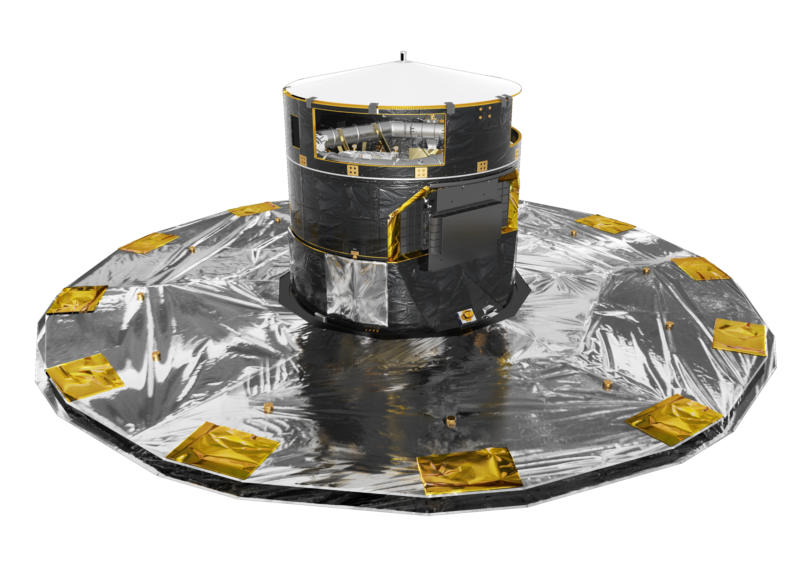
Possible Solutions to the Problem
Open Clusters do have a homogenous stellar population, we then turn to clustering on the CMD and metallicity distribution of targets!
Use of an astrometric study such as Gaia’s second data release to determine population members!
For this study we use Gaia’s star parallax data! Due to its accuracy and similar use in recent studies such as X, X and X
Image courtesy of ESA

Slide 11
The End… Questions? Feedback?

Slide 12
Slides to Aid Potential Questions

